Slide 1
Design Patterns

Slide 2
Types of Design Patterns
01
03
Singelton
Factory
02
04
Registry
Observer

Slide 3
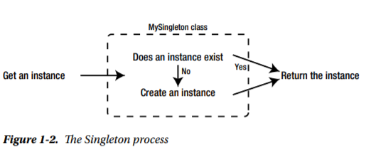
Singleton
Singleton is a design pattern that ensures a class can have only one instance at a time.
A traditional Singleton class maintains one instance of itself in an internal static property, and cannot be cloned in the usual way that a non-Singleton class can.
Singletons have a special instance accessor method, which returns the internal instance property, or creates a new instance to return and store as you can see in the figure.

Slide 4
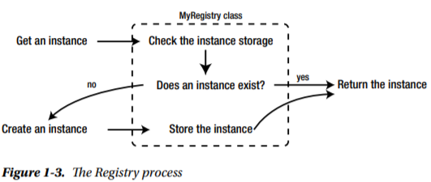
Registry
A Registry is a class that can store and return instances of standard classes.
We use Registry classes to manage a finite amount of class instances, so that we don’t need to keep on reinstantiating classes that the Registry already contains instances of.
Think of it like a team manager that brings players off the playing field and sends new ones in as required.

Slide 5
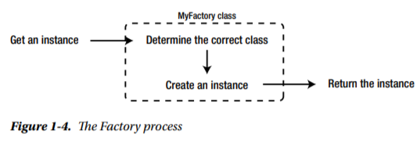
Factory
A Factory is a class that provides a singular interface for creating any number of instances, without actually needing to specify the type of class the instances should be.
A Factory will choose which class to instantiate based on input or internal logic.
Factories are useful when we need to perform database work, but could be dealing with any number of different database drivers. We use a Factory class to give us the correct driver class, ensuring that all of our drivers confirm to a standard interface.

Slide 6
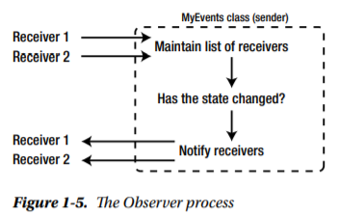
Observer
The Observer pattern describes a structure in which there are senders and receivers.
When something changes in the state of a sender, it sends a message to the receivers associated with it, usually by calling one of their functions.
The most practical uses of this pattern are to implement event-based software, and to facilitate loose coupling in classes only related by changes in application state.

Slide 7
THANKS!
Shivay Bhandari
URN/CRN - 1905398/1921142
Class - IT B2

